Slide 1

MeshCentral
REST vs WebSocket

Slide 2
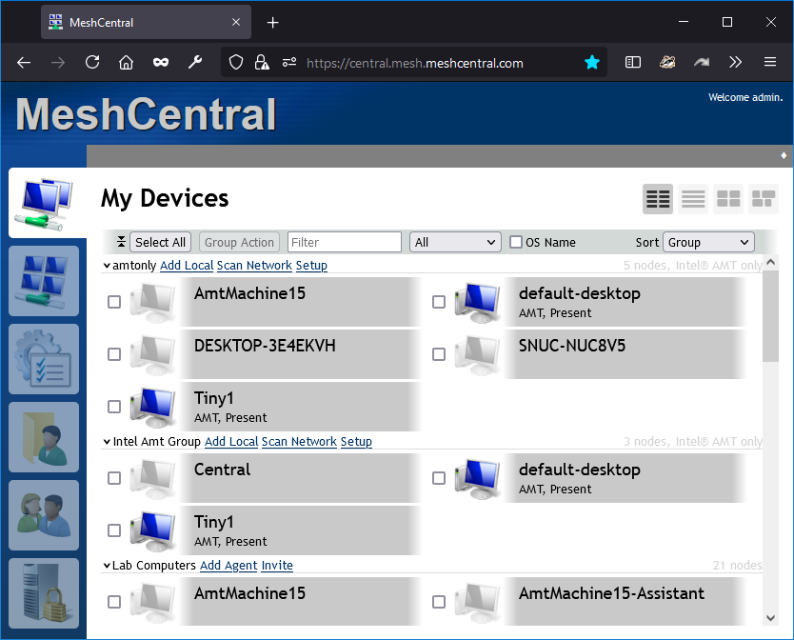
HTTP POST
MeshCentral
https://example.com/control

Slide 3
MeshCentral
Web Socket
wss://example.com/control

Slide 4
Benefits of Web Sockets
Low-overhead
Receive async events
Out of order messages
Compression
Presence indication

